Slide 1


KALINGA INSTITUE OF INDUSTRIAL TECHNOLOGY

Slide 2
VEHICLE ACCIDENT DETECTION AND ALERT SYSTEM
BASED ON IOT AND EMBEDDED SYSTEMS

Slide 3
TEAM MEMBERS
PRATIBHA JAISWAL(1806224)
SHRUTI KESHRI(1705922)
SCHOOL OF COMPUTER SCIENCE

Slide 4
Accident Alert System Features
This system is based on new technology, its main purpose is to detect accident and alert to the nearest help centers, so the victim can get immediate post accident care . It can detect accidents ,the intensity of the accident without any visual contact from rescue centers . The present board designed has both vehicle accident detection and alert system, which make it more valuable and useful. This board alerts us from car damage and on accident detection also.

Slide 5
Usage of alert system in India
As the usage of vehicles is increasing drastically, the hazards due to vehicles is also increased. The main cause for accidents is high speed, drunk and drive, diverting minds, over stress and due to electronic gadgets. Therefore it is important now a days to take safety measures .This paper has many societal contribution as it deals with accident detection system that occurs due to carelessness of the person who is driving the vehicle. This introduces accident alerting system which alerts the trusted contact ,nearest medical center, police station who is driving the vehicle.The cost incured in this project is Rs590.
This system has many other uses other than accident detection like it can be used as vehicle tracking system,theft control system, detects over heating due to any kind of damage .

Slide 6
ABOUT THE PROJECT
The usage of auto mobiles has improved linearly over the past decade, which increased in the risk of human life. This is because due to the insufficient emergency facilities .In this paper we are using a alarm system which helps in improving the alert system due to accident . This system detects the accident occurrence and the co-ordinated of the accident are messaged to the rescue team .A switching system is used switch off in case there are no causality. The car damage is detected with the help of MEMS Sensor . The intensity of the car
damage is indicated through a message. This Application helps in providing feasible solution to the victim with immediate emergency facilitates.
The main intention of this project is to find the accident spot at any place and intimating it to ambulance through the GPS and third party message system. The GPS based vehicle accident identification module contains MEMS, and a button is also provided to stop the messaging process in case on small accident and small injuries so as to save valuable time of rescue centers.
Now-a-days, it has become very difficult to know that an accident has occurred and to locate the position where it has happened. There is no system of identification and intimation regarding an accident in previous system.

Slide 7
CONCEPT AND OVERVIEW
This vehicle tracking system takes input from GPS and send it through the way2sms API to desired mobile/laptop using mobile communication. Vehicle accident detection System is one of the biggest technological advancements to track the damaged vehicle. The security system uses Global
Positioning System GPS, to find the location of the monitored or tracked vehicle and then uses
satellite or radio systems to send to send the coordinates and the location data to the emergency medical service.
At monitoring center of rescue team and trusted contact various software’s are used to plot the Vehicle on a map. In this way the rescue team and trusted contact are able to track their vehicle on a real-time basis. Due to real-time tracking facility, vehicle tracking systems are becoming increasingly popular among owners of expensive vehicles.

Slide 8
HARDWARE
For designing this hardware many types of devices are used to make it perfectly working. All the
devices are purchased from different manufacturers. These components are soldered on a soldering
board. The following list of hardware are required for this system.
GPS
MEMS 6050
NODEMCU
POWER SUPPLY
LED
BUZZER
BUTTON

Slide 9
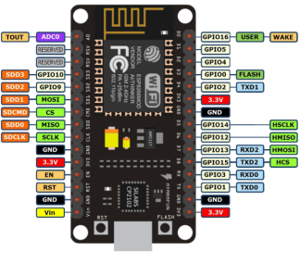
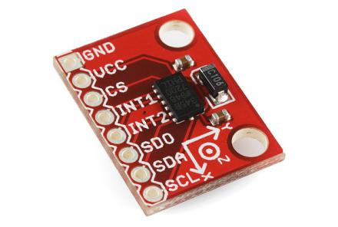
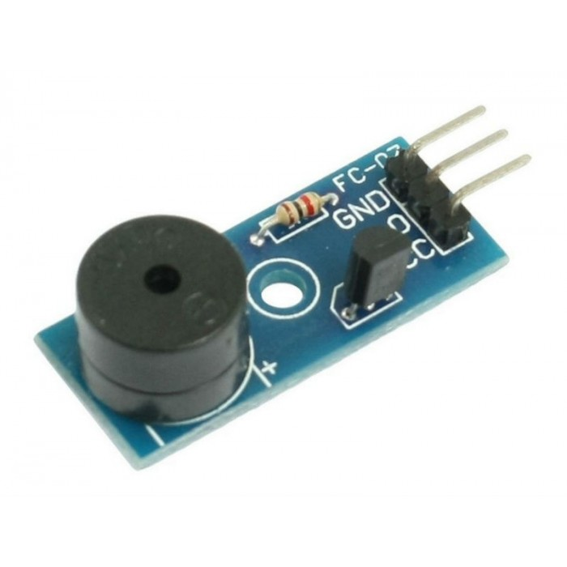
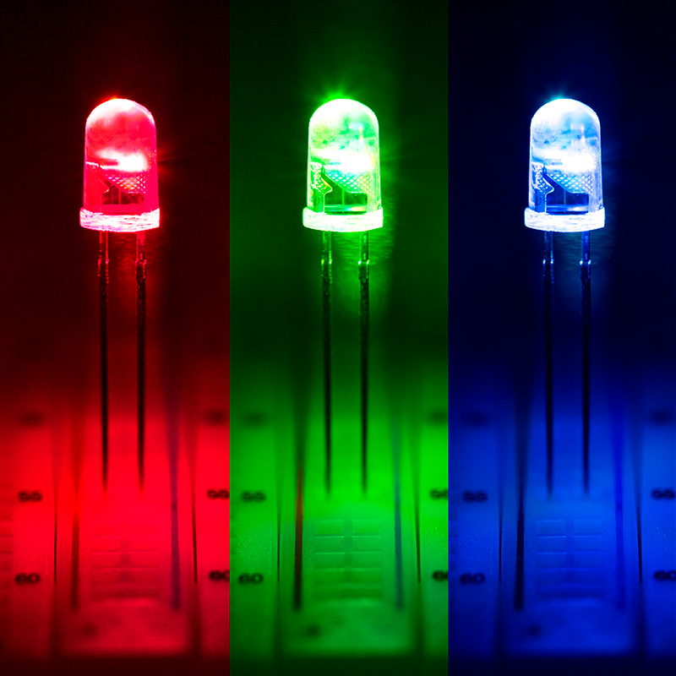
NODEMCU
ACCELEROMETER
BUZZER
LED

Slide 10
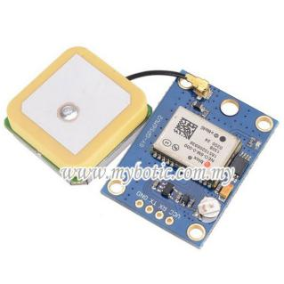

GPS Sensor
BUTTON

Slide 11

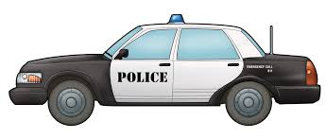


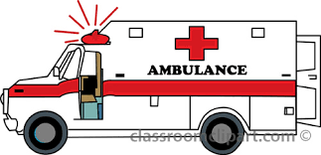
Demonstration
Accident Alert

Slide 12
ADVANTAGES DISADVANTAGES
The vehicle which has there undergone an accident can be identified without communication delay.
The immediate medication will be provided to the accident victims in the remote areas(hiily stations).
The GPS sometimes take around 15-20 mins to receive signal from the satellite.
The accident detection system might dectect harsh driving and get active.

Slide 13
ADVANTAGES DISADVANTAGES
This alert system will
help to recognise accident from a distant and especially.
During foggy conditons and prevent subsequent accidents.
NODEMCU won't work properly without strong network.

Slide 14
FUTURE SCOPE
This system can be interfaced with Vehicle airbag system that prevents vehicle occupants from striking interior objects such as the steering wheel or window.
This can also be developed by interconnecting a camera inside the car and trusted contact that takes the photograph of the accident spot that makes the tracking easier.

Slide 15
FUTURE SCOPE
This project can be used for theft control by futher improvment.
The MEMS in this prototype can detect change in temperature due to car damage ,over heatingdue to close proximity with fire and during accidents by furthur improvement.

